Slide 1
J2EE - Java 2 Platform, Enterprise Edition

Slide 2



Group 1 – Members
Trần Đức Long
Tôn Trí Thiện
Huỳnh Quang Duy
Servlets
J2EE Architecture
JSP (JavaServer Page)

Slide 3
01.
J2EE Architecture

Slide 4
2.1. J2EE Application Model
The Java 2, Enterprise Edition (J2EE) platform is a standard for developing and implementing enterprisewide applications:
It provides multitier applications support.
It is designed to help improve the process of developing, deploying, and implementing enterprisewide applications.

Slide 5
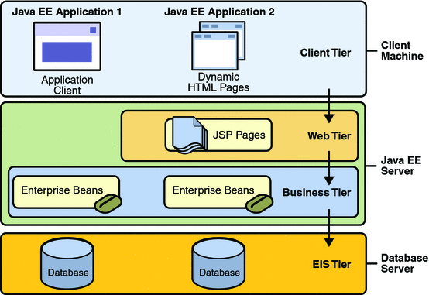
J2EE Platform
Is a multi-tier, distributed application model
Supports component-based J2EE applications

Slide 6
What is multi-tiered application?
Client makes request to the middle tier
Middle tier has the business functions, handles the client requests and processes it
Store the application data in permanent data storage in the data tier
Mainly concentrate on middle tier to make enterprise application easier, robust and secure
Functionality of application is separated into isolated functional areas, i.e. tiers
Client-tier
Middle tier
Data tier (Enterprise Information Systems tier)

Slide 7
2.2 . J2EE Components
Java EE applications are made up of components.
A Java EE component is
a self-contained functional software unit
assembled into a J2EE application with related classes and files
communicates with other components
Components are reusable
Several type of components:
Client-tier components
Web components
Business-tier components

Slide 8
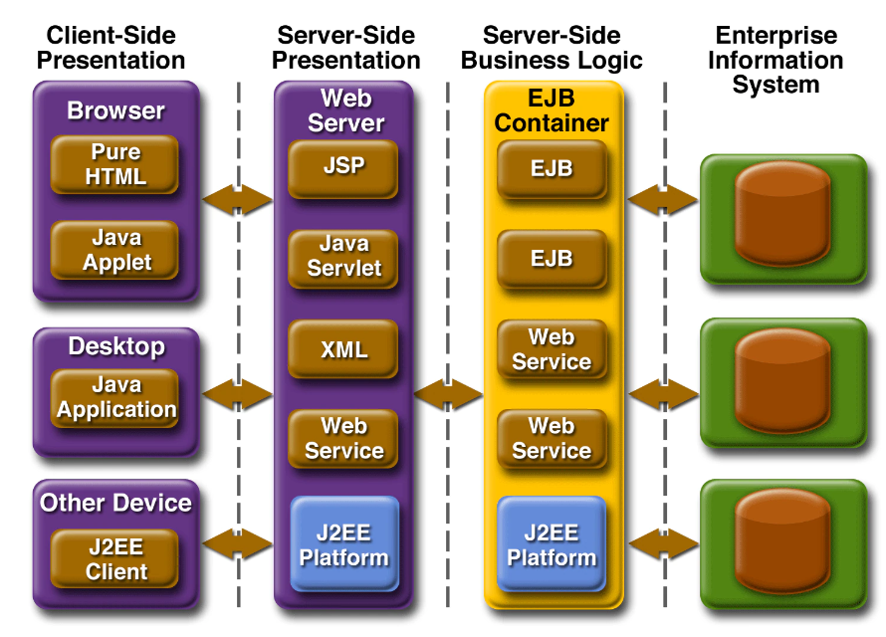
J2EE Components
Client-tier components, such as a Web browser, run on the client machine.
Presentation logic is built with Web-tier components such as JavaServer Pages (JSP), HTML, XML and Java Servlets that run on the J2EE server.
Server-side business logic is distributed as business-tier components that run on the J2EE server. Enterprise JavaBeans (EJB) is an example of business-tier components.
Data is stored in the Enterprise Information System (EIS) tier that runs on the database server.

Slide 9
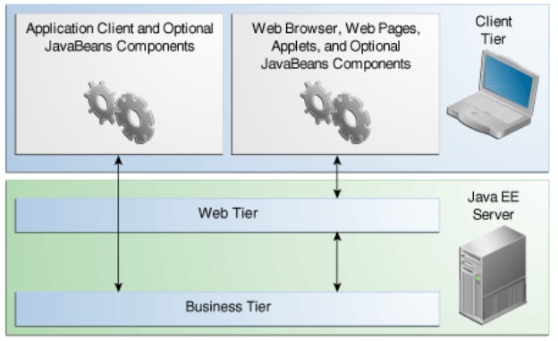
Client-tier components
Web browser client:
Is used for a web-based J2EE application.
A web client consists of two parts:
Dynamic web pages
A web browser
Is a thin client.
Heavyweight operations are off-loaded to enterprise beans executing on the J2EE server.

Slide 10
Client-tier components
Application:
Is used for a non-web-browser-based J2EE application
Executes on the client machine
Can contain a graphical or command-line interface
Is a thick client
Accesses business-tier components or a Servlet on the web tier

Slide 11
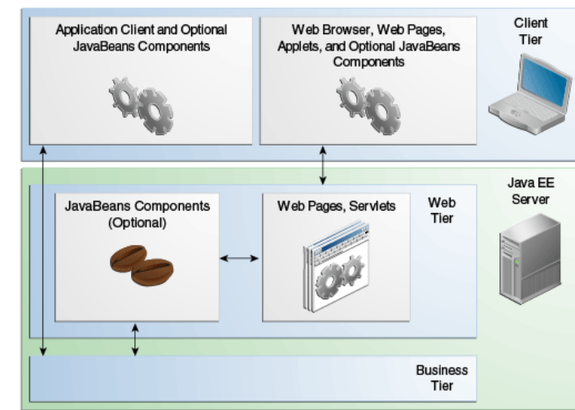
Web-Tier Components
A web tier may consist of:
Java Servlets
JSPs
Servlets and JSPs:
Work on a request-response model
Generate HTML dynamically
Access the database through JDBC
Access the business-tier components
Handle user-centric events, such as an HREF link or form submission

Slide 12
Web-Tier Components
In summary:
Web-tier components generate dynamic content.
Servlets:
Extend web server functionality
Are designed more for processing than for presentation
JSPs:
Combine HTML (or other markup) and Java
Are designed to separate content creation from presentation logic
Are precompiled and converted to Servlets at runtime

Slide 13
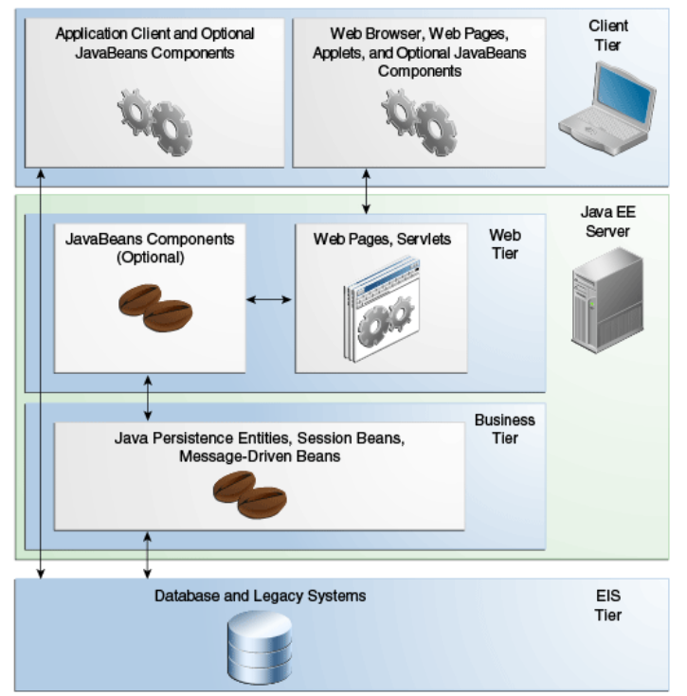
Business-Tier Components
Are EJBs
Handle business logic
Receive data from client programs
Retrieve data from database storage
Process the data and communicate with the database and the client program
Can be invoked by the Web-tier components

Slide 14
EIS Tier
The enterprise information system tier handles EIS software and includes enterprise infrastructure systems, such as
enterprise resource planning (ERP)
mainframe transaction processing, database systems
other legacy information systems
For example, Java EE application components might need access to enterprise information systems for database connectivity.

Slide 15
Pros & Cons
Pros
Cons
Runs on any operating system and application server (may need adjustments)
Handles complex, high- volume, high-transaction applications
Has more enterprise features for session management, fail-over, load balancing and application integration
Is favored by experienced enterprise vendors such as IBM, BEA, SAP and Oracle
Offers a wide range of vendor choices for tools and application servers
Has a proven track record
Has a complex application development environment
Tools can be difficult to use
May cost more to build, deploy and manage applications
Lacks built-in support for Web services standards
Is difficult to use for quick-turnaround, low-cost and mass-market projects

Slide 16

02
SERVLETS

Slide 17
CONTENTS:
2.1. Web & HTTP
2.2. Introduction to Servlets
2.3. Servlet Lift Cycle
2.4. Step to create Servlets
2.5. Session Tracking
2.6. Cookies

Slide 18

2.1. Web & HTTP
A Java Servlet is a program that runs on the Web or an application server and acts as an intermediary layer between a request coming from a Web browser or an HTTP client (Client) and a database or applications on the HTTP server.
Using a Servlet, you can collect input from users via web formats, from a database or another source, and generate web pages.
Http (HyperText Transfer Protocol) is a hypertext transfer protocol used in www to transfer data between Web servers to Web browsers and vice versa.

Slide 19
2.2. Introduction to Servlets
Servlets are the Java programs that runs on the Java-enabled web server or application server. They are used to handle the request obtained from the web server, process the request, produce the response, then send response back to the web server.
Properties of Servlets :
Servlets work on the server-side.
Servlets are capable of handling complex requests obtained from web server.

Slide 20
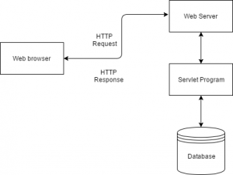
2.2. Introduction to Servlets
Execution of Servlets involves six steps:
1. The clients send the request to the web server.
2. The web server receives the request.
3. The web server passes the request to the corresponding servlet.
4. The servlet processes the request and generates the response in the form of output.
5. The servlet sends the response back to the web server.
6. The web server sends the response back to the client and the client browser displays it on the screen.

Slide 21
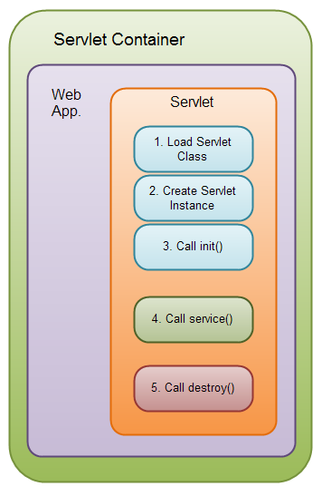
2.3. Servelts Life Cycle
There are three states of a servlet:
NEW – READY – END
The servlet is in new state if servlet instance is created and init() method is called
After invoking the init() method, Servlet comes in the ready state. In the ready state, servlet performs all the tasks, service() method is invoked
When the web container invokes the destroy() method, it shifts to the end state.

Slide 22
2.4. Create Servlets
We are going to use apache tomcat server in this example. The steps are as follows:
Create a directory structure
Create a Servlet
Compile the Servlet
Create a deployment descriptor
Start the server and deploy the project
Access the servlet

Slide 23
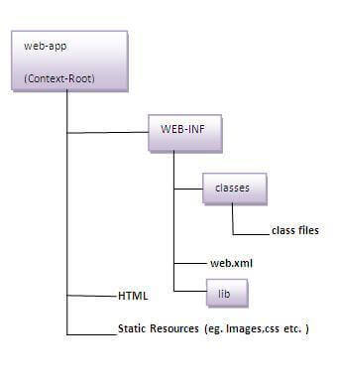
2.4. Create Servlets
Step 1: Create a directory structure
The directory structure defines that where to put the different types of files so that web container may get the information and respond to the client.
As you can see that the servlet class file must be in the classes folder. The web.xml file must be under the WEB-INF folder.

Slide 24
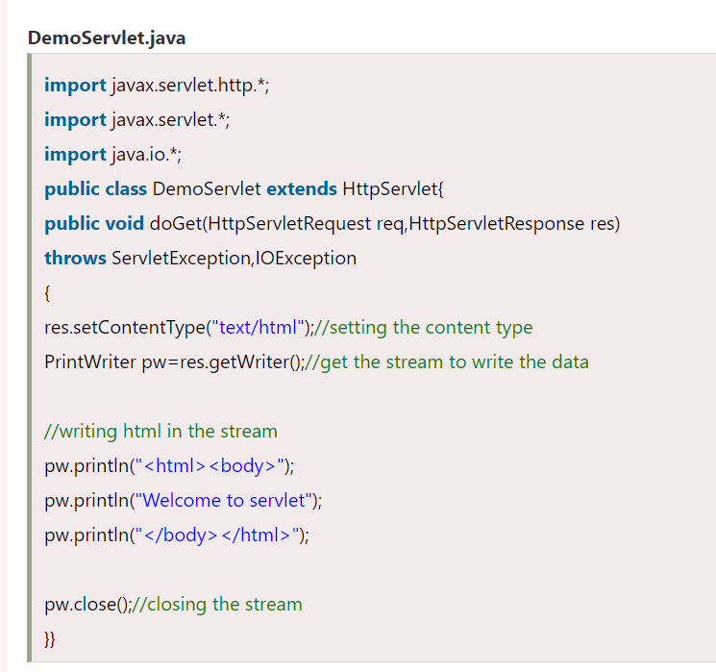
2.4. Create Servlets
Step 2: Create a Servlet
There are three ways to create the servlet. By implementing the Servlet interface By inheriting the GenericServlet class By inheriting the HttpServlet class The HttpServlet class is widely used to create the servlet because it provides methods to handle http requests such as doGet(), doPost, doHead() etc.

Slide 25
2.4. Create Servlets
Step 3. Compile the Servlet
For compiling the Servlet, jar file is required to be loaded. Different Servers provide different jar files:
Jar file | Server
1) servlet-api.jar | Apache Tomcat
2) weblogic.jar | Weblogic
3) javaee.jar | Glassfish
4) javaee.jar | JBoss
Two ways to load the jar file set classpath paste the jar file in JRE/lib/ext folder Put the java file in any folder. After compiling the java file, paste the class file of servlet in WEB-INF/classes directory.

Slide 26
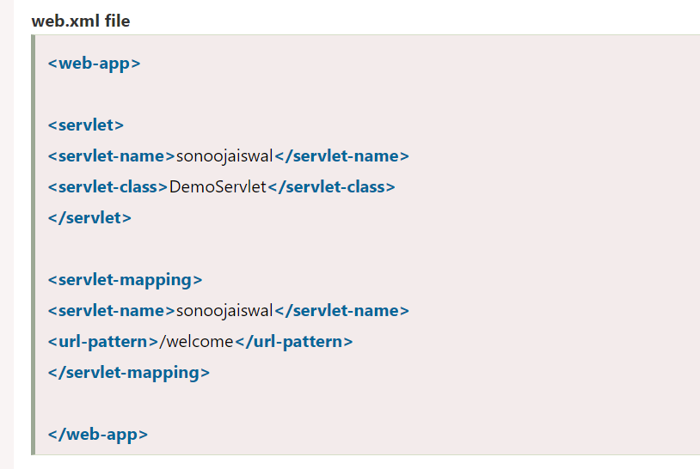
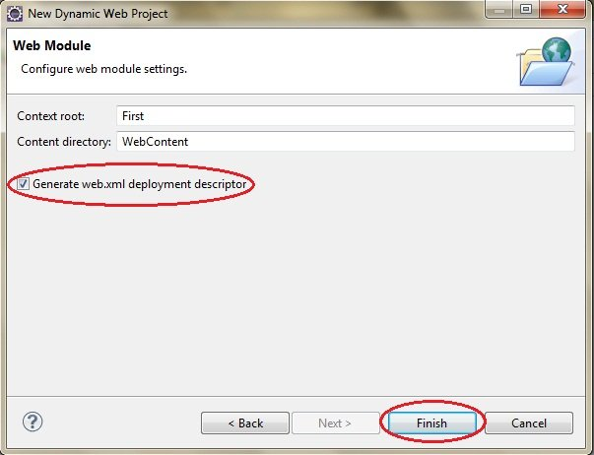
2.4. Create Servlets
Step 4. Create a deployment descriptor
The deployment descriptor is XML file, from which Web Container gets the information about the servlet to be invoked.
The web container uses the Parser to get the information from the web.xml file. There are many xml parsers such as SAX, DOM and Pull.

Slide 27
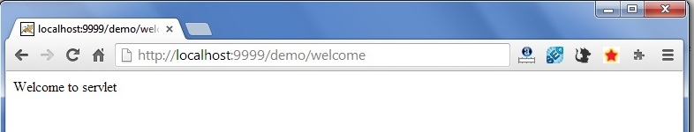
2.4. Create Servlets
Step 5. Start the Server and deploy the project
set JAVA_HOME or JRE_HOME in environment variable (It is required to start server).
Change the port number of tomcat (optional). It is required if another server is running on same port (8080).
.
Step 6. Acess your project.
Open browser and write “http://hostname:portno/contextroot/urlpatternofservlet.”
For example: http://localhost:9999/demo/welcome

Slide 28
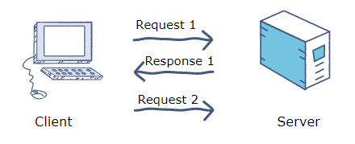
2.5. SESSION TRACKING
Http Protocol is a stateless so we need to maintain state using session tracking techniques. Each time user requests to the server, server treats the request as the new request. So we need to maintain the state of an user to recognize to particular user.
Session Tracking is a way to maintain state (data) of an user. It is also known as session management in servlet.
There are four techniques used in Session tracking:
Cookies
Hidden Form Field
URL Rewriting
HttpSession
If session tracking is not used, request 2 is treated as a new request without the server recognizing that it is from the same user.

Slide 29
2.6. COOKIE
Cookies help users access the Website faster, more convenient, and do not take too long to log in again and again.
A cookie is a unique ID assigned to clients when they first visit a website. Whenever this client connects to the server again, it will send the cookie that was given earlier by the server. The server will then recognize that it is the same user.
Cookie will record information such as login name, password and options selected by user. This information is stored in the computer to identify the user when visiting a website
Cookies will be easily targeted by hackers, trying to break to steal information and use it for malicious purposes.

Slide 30

3. JSP (JavaServer Pages)

Slide 31
3.1. Introduction to JSP
JavaServer Pages (JSP) is a Java standard technology
It is a server side technology
A JSP page consists of HTML tags and JSP tags
JSP technology is the extension to Servlet technology
JSP can be easily managed
No need to recompile and redeploy
Less code then Servlet

Slide 32
3.2 JSP vs SERVLET
Key | JSP | Servlet
Implementation | Developed on Java language. | Mainly written in HTML although Java code could also be written on it
MVC | Looks like a controller which receives the request process and send back the response. | Plays the role of view to render the response returned by the servlet.
Request type | Can accept and process all type of protocol requests. | Only compatible with HTTP request.
Session management | By default, session management is not enabled, the user has to enable it explicitly. | Automatically enabled.
Performance | Faster | Slower
Modification reflected | Modification in Servlet is a time-consuming task | modification is fast

Slide 33
3.3 JSP Scripting Elements
* Scripting elements in JSP must be written within the <% %> tags
<!DOCTYPE html>
<html>
<head>
<title>This is Group 1</title>
</head>
<% int cnt = 6; %>
<body>
Calculated page count is <% out.println(cnt); %>
</body>
</html>

Slide 34
3.3 JSP Scripting Elements
Here are five different scripting elements:
+ Comment <%-- Set of comment statements --%>
+ Directive <%@ directive %>
+ Declaration <%! declarations %>
+ Scriptlet <% scriplets %>
+ Expression <%= expression %>

Slide 35
3.3 JSP Scripting Elements
a. Comment
Comments are marked as text or statements that are ignored by the JSP container
<!DOCTYPE html>
<html>
<head>
<title>This is Group 1</title>
</head>
<body>
<%-- This is a JSP comment --%>
</body>
</html>

Slide 36
3.3 JSP Scripting Elements
b. Directive
These tags are used to provide specific instructions to the web container when the page is translated. It has three subcategories:
Page: <%@ page ... %>
Include: <%@ include ... %>
Taglib: <%@ taglib ... %>

Slide 37
3.3 JSP Scripting Elements
<%@page import="java.util.List"%>
<%@page language="java" contentType="text/html; charset=UTF-8" pageEncoding="UTF-8" %>
<%@taglib uri="http://java.sun.com/jsp/jstl/core" prefix="c" %>
<!DOCTYPE html>
<html>
<head>
<title>This is Group 1</title>
</head>
<body>
</body>
</html>

Slide 38
3.3 JSP Scripting Elements
c. Declaration
It is used to declare methods and variables you will use in your Java code within a JSP file
<!DOCTYPE html>
<html>
<head>
<title>This is Group 1</title>
</head>
<body>
<%! int variable_value=62; %>
<%= " Your integer data is :"+ variable_value %>
</body>
</html>

Slide 39
3.3 JSP Scripting Elements
d. Scriptlet tag
The scriptlet tag allows writing Java code statements within the JSP page.
<!DOCTYPE html>
<html>
<head>
<title>This is Group 1</title>
</head>
<body>
<table border="1">
<% for ( int g = 1; g <= cnt; g++ ) { %>
<tr>
<td>Number</td>
<td><% = g+1 %></td>
</tr>
<% } %>
</table>
</body>
</html>

Slide 40
3.3 JSP Scripting Elements
e. Expression
Expressions elements are responsible for containing scripting language expression, which gets evaluated and converted to Strings by the JSP engine and is meant to the output stream of the response.
<!DOCTYPE html>
<html>
<head>
<title>This is Group 1</title>
</head>
<% int cnt = 6; %>
<body>
<%= "this is a string" %>
</body>
</html>

Slide 41
3.4 Request and Response
a. Request
The JSP request is an implicit object which is provided by HttpServletRequest
In JSP, the request object is implicitly defined
JSP request object is created by the web container for each request of client

Slide 42
3.4 Request and Response
<!DOCTYPE html>
<html>
<head>
<title>This is Group 1</title>
</head>
<body>
<form action = "Group1.jsp">
<input type = "text" name = "username">
<input type = "submit" value = "submit">
</form>
</body>
</html>

Slide 43
3.4 Request and Response
b. Response
This is the HttpServletResponse object
The response object also defines the interfaces that deal with creating new HTTP headers
In JSP, the response object is implicitly defined
JSP response object is created by the web container for each request of the client

Slide 44
3.4 Request and Response
<!DOCTYPE html>
<html>
<head>
<title>This is Group 1</title>
</head>
<body>
<%
response.sendRedirect("google.com");
%>
</body>
</html>

Slide 45
3.4 Request and Response
<!DOCTYPE html>
<html>
<head>
<title>This is Group 1</title>
</head>
<body>
<%
String name=request.getParameter("username");
out.print("Welcome "+ name);
%>
</body>
</html>

Slide 46
THANK YOU

